Slide 1
Instructions for the facilitator
The facilitator’s handbook provides you with the support material you need to facilitate a Futures Frequency workshop. The handbook can be downloaded at www.futuresfrequency.fi
  The facilitator’s handbook includes detailed instructions for each stage of the workshop and scripts for the facilitator’s spoken parts. The spoken parts can also be found from the PPT notes
The method can be used and adapted according to the needs of the group and the context. You may also edit the slides and, for example, copy the content to your own template. Please remember to cite the original version.
  This PPT presentation was designed especially for online workshops
You may have a look the Miro template we have used at www.futuresfrequency.fi Any other online platforms work as well.
What kinds of futures frequencies did you get tuned into? What did you find difficult or surprising? What inspired you? What insights did you get? Join the conversation on social media. Use the hashtag #futuresfrequency
We’d be happy to hear your feedback, wishes and questions. You can reach us at tulevaisuustaajuus@sitra.fi

Slide 2
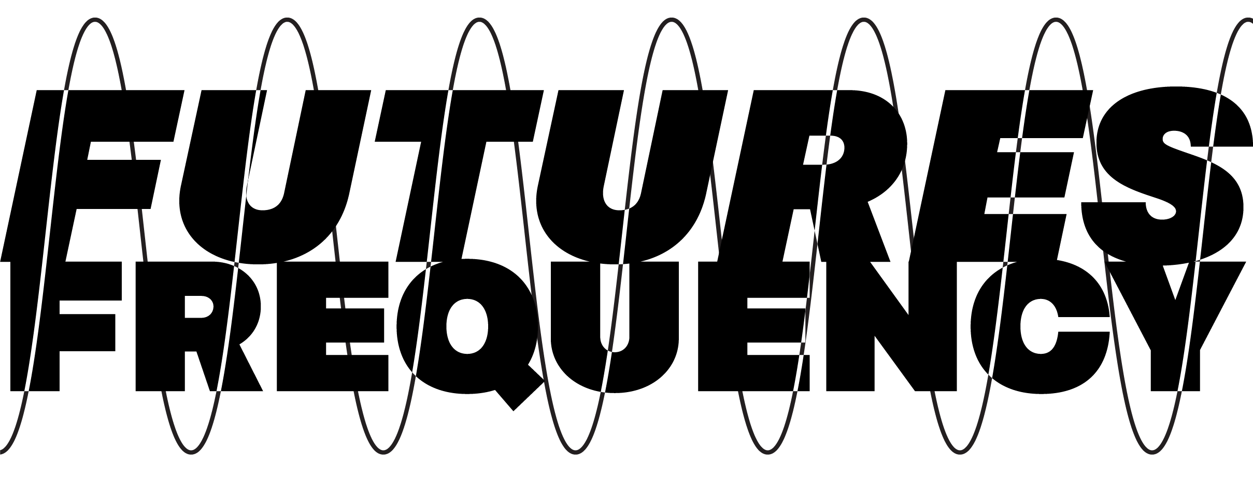
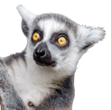
Here we go!
Notes:
Welcome to the Future Frequency. This is a 3 hour workshop for everyone interested in influencing the future.
With this workshop we aim to make foresight and change making more inclusive and understandable. Meaning that you don’t have to be a foresight professional to get a grip on these issues and start applying them in your own work. One of the background ideas is also that if we are going to succeed in the transition that the ecological crisis demands from our societies, we need more people and organisations to join the work and feel that they have agency and skills to have an influence.
When we have completed the workshop today, you will hopefully have a clearer picture of what kind of future you want to shape and how. You will have challenged your own ideas about the future, imagined a desirable future and, finally, design actions toward it. In the end of the workshop, we would appreciate your feedback.

Slide 3
The Future.
What comes to mind?
Notes:
Let’s start with this question. Please tell us your name and in just one or two words, what comes to mind with the word “future”. There are no right or wrong answers.

Slide 4
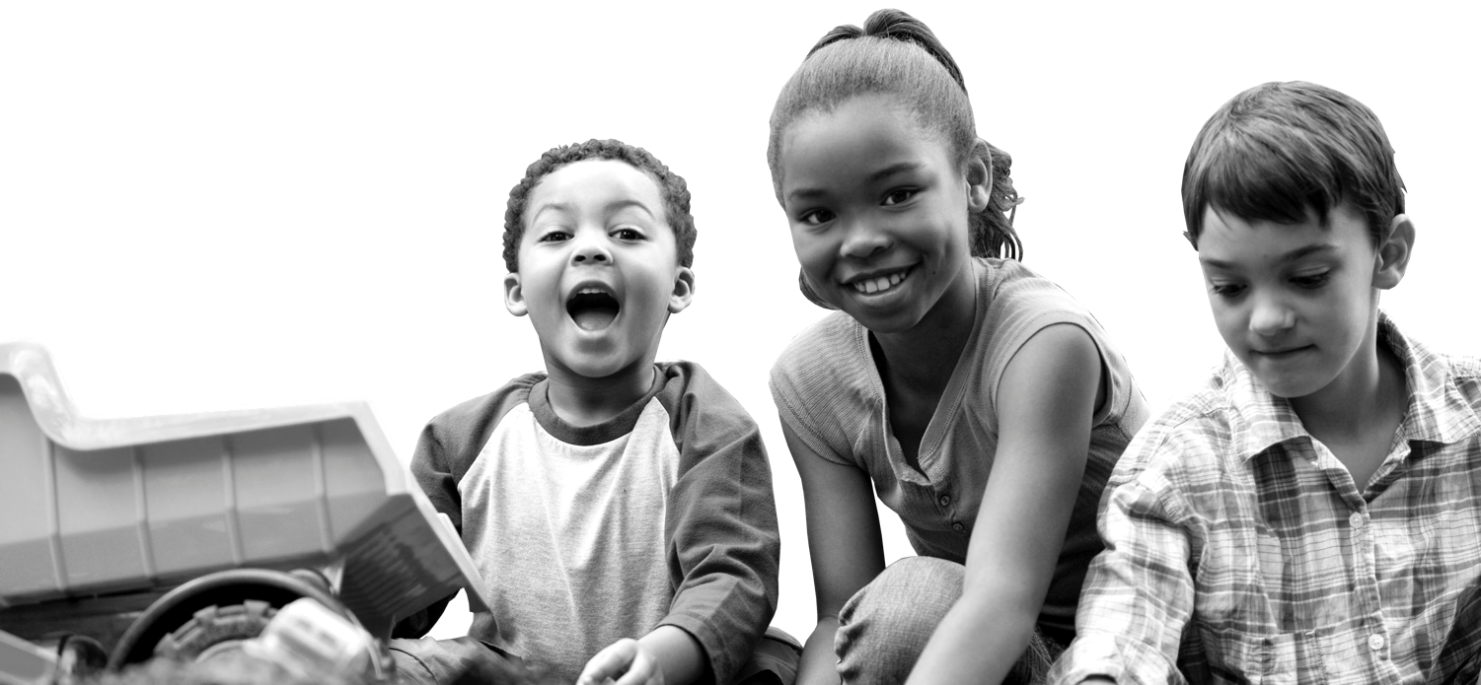
The Future? What time frame are we talking about?
Today’s workshop looks to the year 2050. We’ll be in our thirties then!
Notes:
The word “future” can refer to tomorrow or a hundred years from now. In Future Frequency, we look to the year 2050, three decades ahead. That gives us a long enough time frame to cut loose from the restrictions of the present.

Slide 5
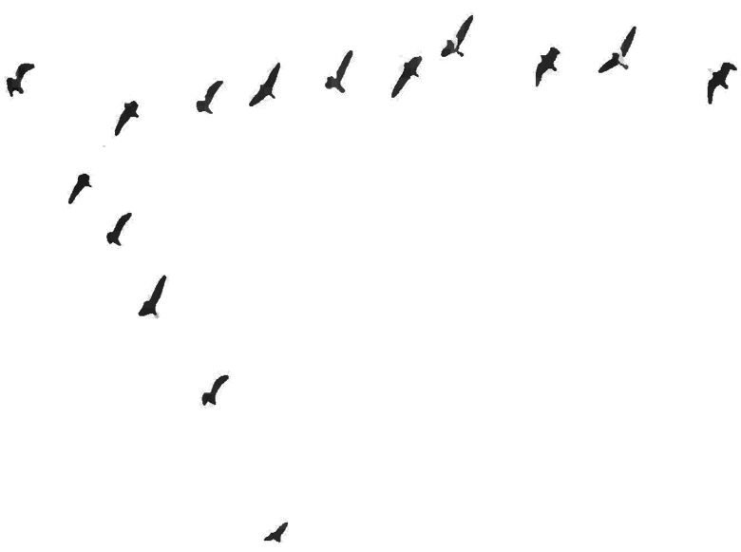
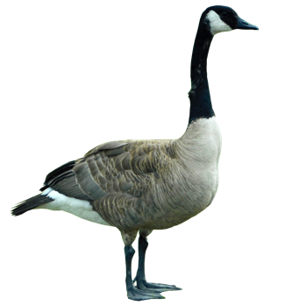
3.5%
Notes:
Some of us may be familiar with a sense of cynicism about how much impact one person can have, but this quote from anthropologist Margaret Mead summarises something quite essential: “Never doubt that a small group of thoughtful, committed, citizens can change the world. Indeed, it is the only thing that ever has.”
The 3,5 percent rule
-There’re plenty of examples in the world history of how from the actions of a small group of people there has been major changes in societies – both good and bad
-One example is the so called 3,5% rule. It is based in research done about non-violent civil movements. The main observation is that when 3,5 % of citizens join a movement, it succeeds in its goals and major political changes happen

Slide 6
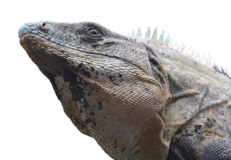
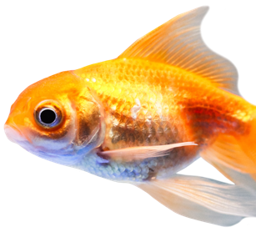
Today’s working methods
Working groups
Miro
Template for individual and small group work
Group 1:
Iguanas
Group 2:
Fish
Zoom
Large group discussion and small group discussion
And so on…
Altogether xx groups
Notes:
You will be divided into small groups. You will work in these groups during the workshop. We will use two technical tools: 1. Zoom and 2. Miro
The workshop is quite fast paced so don’t get stuck doing the exercises for too long.

Slide 7

Listen to others, do not interrupt
or start additional side discussions.
Join the discussion and use everyday language.
Be present and respect others
and the atmosphere of openness to new ideas.
You don’t have to agree, but lets
be constructive.
Together we move from thinking towards doing.
Notes:
We apply these rules for the workshop. They have been applied from the Timeout dialogues concept. Ideas about the future can be quite personal, so it is important to create a safe space for everyone.
Listen to the others, don’t interrupt
or start additional side discussions.
Join the discussions and use everyday language.
Be present and respect others
and the atmosphere of openness for new ideas.
You don’t have to agree, but lets
be constructive.
Together we will take steps from thinking towards doing.

Slide 8
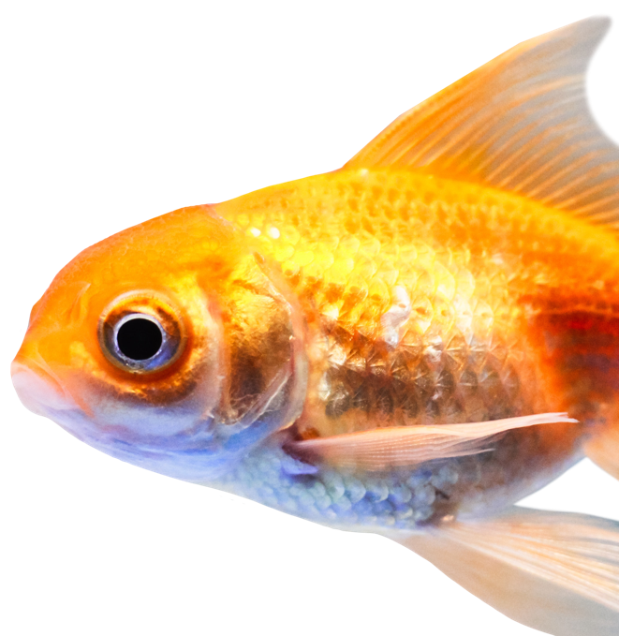
Tune in to the working mode
How is this done in practice?
Open Miro (link in the chat). Let’s check out how it works.
Write your name and greetings in the first frame.
How’s this gonna work?

Slide 9
The structure of Futures Frequency
!
Intro: Why does a change maker need futures thinking?
1
Challenge existing assumptions about the future.
2
Imagine a preferred future.
We’ll have
a 10
min
break
3
Take action and shape the future.
Notes:
The structure of Future Frequency
First, we will get you tuned to the right frequency with a brief lecture section.
Then, we will challenge our assumptions about the future. This is especially important because our assumptions about the future guide our thinking, decisions and actions.
Then, we will use our imaginations! Imagining is one of the elements of Future Frequency because it’s difficult to carry out a future that we can’t imagine. That’s why there is such a big need for hope induced images of possible futures.
Lastly, we will take our first steps towards our desired future.
Don’t worry if you can’t remember this structure. We’ll make sure you stay on board for the entire ride. You can make your workshop experience easier by closing all other tabs and focusing exclusively on this workshop.

Slide 10

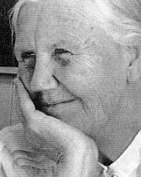
IPRA Foundation
Notes:
We’ll start with the story of an impressive woman. It’s a story that touches on future-oriented thinking as well as being an agent of change.
The Norwegian-born sociologist Elise Boulding took part in a peace movement conference after World War II. In a panel discussion at the conference, she asked disarmament experts what a world without weapons would look like and how it would function. None of the experts had an answer. Boulding realised that the peace movement was working on peace without knowing what a peaceful world would look like.
“They didn't know what they were working for. It would just be a world with no weapons and no war. But what kind of society would it be? What kind of institutions?”
Boulding began to hold workshops to imagine a world without weapons. The participants were asked to travel 30 years into the future in their minds and describe what a world without weapons would actually look like. Following a group discussion, the participants were asked to “think back to the future”, or draw a timeline backwards to the present, to describe how the world they imagined had been achieved. Finally, the participants were asked to decide what they would do, starting right then, to help that process along.
The starting point of Boulding’s workshop was to challenge the assumptions of the present time: what if there were no weapons and no war? However, for us to really work towards a desirable future, we also need to imagine it at a more detailed level. What things could be different? And how? And what would stay the same? Later on in 1990 Boulding was nominated for the Nobel peace Prize.
Challenging and listening provide the foundation for imagining futures, but they alone are not enough for achieving change. To achieve change, you also need to prepare concrete plans, apply yourself, inspire other people to get involved and set up meetings – in other words, do all the time-consuming things that it takes to get the work done.
Today, our aim is to do all of the things that Elise and many other change agents have done: challenge assumptions about the future, imagine a better tomorrow and take concrete action. All of this requires a psychological sense of security. So let’s be especially kind to each other.

Slide 11
“What if there were no weapons in the world?”
Elise Boulding
Notes:
But first, let’s return to Elise’s story for a moment. Elise had the courage to ask a difficult question. While the question itself did not change the world, it broadened the views of those who worked in the peace movement on what the future could be like – and it inspired them to work even harder, and with greater commitment, towards that desirable future.
The real agents of change have always also been futurists. They have had the courage to question things and imagine something which is not yet visible. Here we have a few examples of questions that were once asked

Slide 12
What if…
What if everyone could get a loan – even if you’re poor?
What if we had no waste?
What if all kids could go to school?
What if countries that were at war with each other were to create a community?
What if everyone had the right to a home, even if you’re homeless?
Notes:
Besides Elise, many other agents of change have had to ask questions of this nature. Muhammad Yunus, who pioneered the concept of microcredit, asked “What if everyone could get a loan – even the poor?”
Jean Monnet, one of the founding fathers of the European Union, asked “What if countries that were previously at war with each other were to create a community?”
What if nature had legal rights?
What if we had no waste?
What if we could make protein from air?

Slide 13
Lets tune in to Futures Frequency
How?
You can come up with one or more “What if?” questions that would take us towards the future that you prefer. The question can be on any topic.
Write your “What if” question on the Miro board.
We will all do this at the same time. If you can’t think of anything, look for inspiration from the other participants’ questions. You’re sure to find an idea that gets your mind going!
PSSST!
There is no pressure to know the answers,
only the freedom to ask!

Slide 14
Futures thinking
!
There are many possible futures.
We can influence them.
We have a responsibility to think long term.
Notes:
If we had to summarise futures thinking in three points, this what they would look like.
There are many possible futures. We should think about the future in plural. There is no single track that we are on. Rather, the future is shaped by our actions and decisions in the present. The future is also shaped by the things we don’t do.
We can influence them because the future does not just happen by itself.
We have a responsibility to think about the long-term. This especially concerns future generations. We cannot only focus on the present, but must act so that future is better and not worse than now.

Slide 15
Futures cone
Possible
Plausible
Probable
Preferable
Scenarios
Wild cards
Adapted from: Voros 2017
Notes:
We can think of the future as a cone. Everyone of us has a personal cone of what we think is possible, probable and preferable regarding the future.
It’s also interesting to consider what we characterise as preferable futures, meaning what is the direction we would like to move towards. This is why we create scenarios. They are one way by which we try to make the uncertainty about the future more manageable. Wild cards are surprising events that we need to try to take into consideration in what we do.

Slide 16
Our cone of futures is often too narrow
Trump
Impossible or implausible
Corona
Possible
Plausible
Probable
Preferable futures
Descriptions of preferable futures
Brexit
Thinking the wild cards through
Adapted from: Voros 2017
Notes:
However, the traditional model of the cone of possibilities is not best suited to our present moment, which is characterised by complexity and vagueness. Our cone of possibilities is too narrow. The range of possibilities we consider plausible and probable is too narrow. That’s why we are surprised when something unexpected happens (Brexit, COVID-19, etc.) This makes it necessary for us to expand our cone of possibilities and to imagine impossible or implausible futures.
What all this means is that we should challenge our assumptions and expand our thinking about the future. It’s also important to think about what actually is desirable in the future. There is no shortage of threats in our time, but there is a shortage of inspiring and hopeful future scenarios.

Slide 17

!
Challenge existing assumptions about the future
Why? Because our thoughts about the future guide our actions in the present.
1
2
3
Notes:
If we fail to challenge old perspectives and assumptions, or if we fail to challenge the thoughts and ideas of a small group of people, we may end up in a future that does not reflect our values. Our thoughts about the future guide our actions in the present.

Slide 18
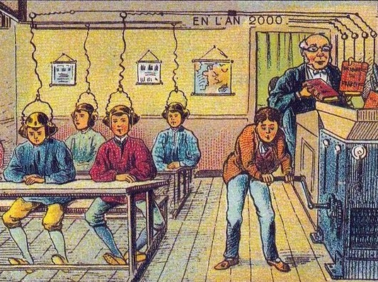
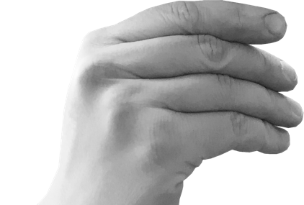
Notes:
The assumptions that we have about the future affect our thoughts and that way our actions in the present day.
This picture is by a French artist from 1901. And this is how he thought a school classroom would look like in 2000.
You can see that the class only has boys. The students have some kind of headphones. One of the students uses a mill where the teacher pours some books and somehow the information is transferred to the students head.
So the image is quite technology focused as the future images often are.
It is also interesting to see what is thought to remain the same. The students sit in rows for example and the teacher is in a podium. Even though classroom is not exactly like this nowadays, these kind of thoughts have impacted on how school has been developed.

Slide 19
Challenge assumptions about the future
How? Assignment 1
Split up into groups for 10 minutes.
Each group is given an audio play relating to an assumption about the future. The links to the audio plays are in Miro. Listen to the audio play individually.
Then discuss the audio plays as one assumption of a possible future.
  Do you recognise this kind of assumption about the future? Do you agree with it?
  Challenge: on what kind of assumptions is it based?
The questions can also be seen in Miro.
After 10 minutes, return to the larger group.
Notes:
What should you challenge? We all have assumptions about the futures that we should be aware of since they affect our actions today.
REFLECTION
Now you get to challenge only one assumption about the future. All other assumptions about the futures should be challenged as well.
If we now consider our previous discussions and link it to our thinking: do you recognise what kind of assumptions you make about the future?
Facilitator, you may post in the chat: did you recognise some of your own personal assumptions about the future? If so, what?

Slide 20
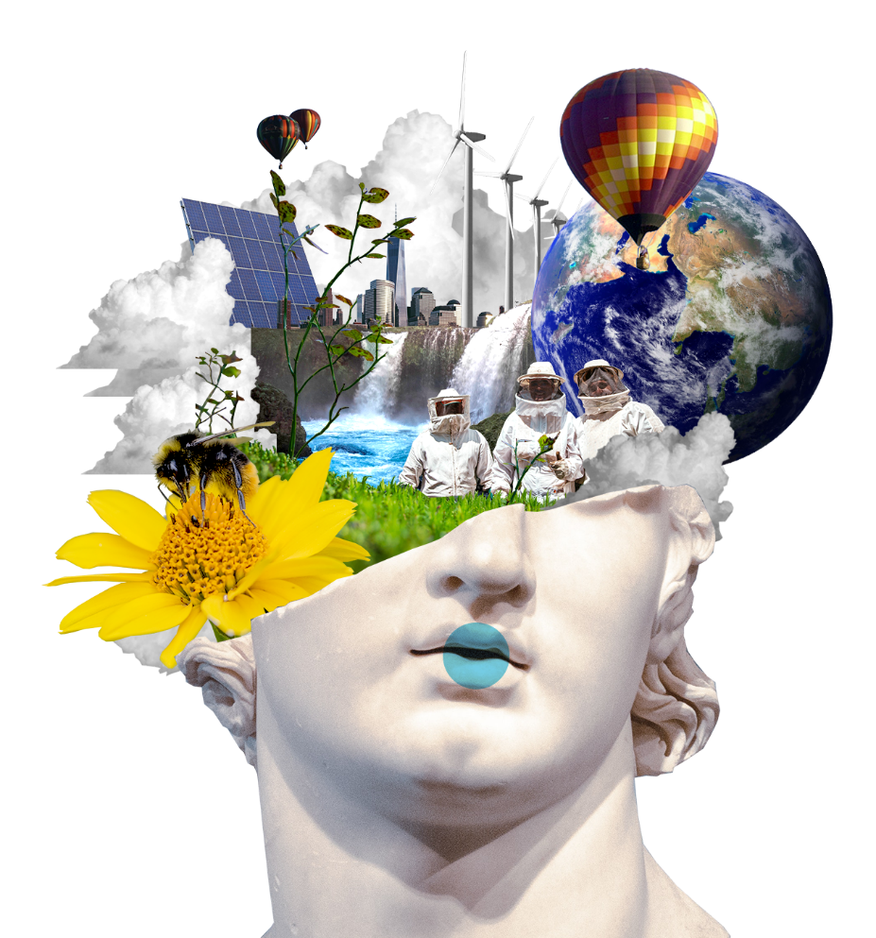
!
1
Imagine a preferred future
Why? Because it’s difficult to realise a future that we can’t even imagine.
2
3
Notes:
We now move on to the second stage of the workshop: to imagine what a preferred future within the earths carrying capacity looks like.
Challenging assumptions about the future and the present state of affairs is not enough in itself. We also need to use our imagination. Whenever the world has changed, someone must have been able to imagine what a better transport system or a world with fewer weapons would look like.
Imagination is a human superpower that separates us from the other animals.
As Yuval Noah Harari states in his well-known book Sapiens, as far as we know, only Homo sapiens can talk about things we have never seen, touched or smelled.
Earlier on in the workshop, we asked “What if”. We will now go back to that and think more deeply about how things could be different.
-Same areas in our brain activate when we remember the past or imagine the future. Imagining a future is linked to our ability to remember.
-Scientists detected first signs of this phenomena when they were treating a patient suffering from memory loss. When the patient had lost her ability to remember it seemed like she had also lost her ability to imagine what is to come.

Slide 21
Let's look back for a moment

Slide 22
How have things changed earlier?
How? Assignment 2
Let’s use Miro and do this together at the same time.
Put Post-its on the timeline
  Looking back: What has influenced the way the present moment is?
  Looking forwards: What things are now shaping the future?
1940
1960
1980
2000
2020
Comprehensive school for all
Berlin Wall falls
Finland joins the EU
Pulled Oats
Notes:
Let’s look to the past for a moment to see different events that have happened in the 20th and 21st century and that have affected how 2020 or 2021 looks like. The idea of the exercise is to activate your brains to do futures thinking and to understand things in a long-term perspective.

Slide 23
How will we proceed?
2
1
3
Visualise individually
Share and discuss
Find a common direction
4
5
Work in that direction
Ideate actions

Slide 24
Imagine a preferred future
How? Assignment 3
You’ll work independently for about 7 minutes.
Use pen and paper or start a blank document.
Choose a theme for your preferred future. Think what is positive in the present moment that you wish to strengthen to make a better future?
Explain how the future would be better and for whom? Be specific.
  I wish to strengthen what, so that in 2050 what will be different/ what has happened / what will the world be like.

Slide 25
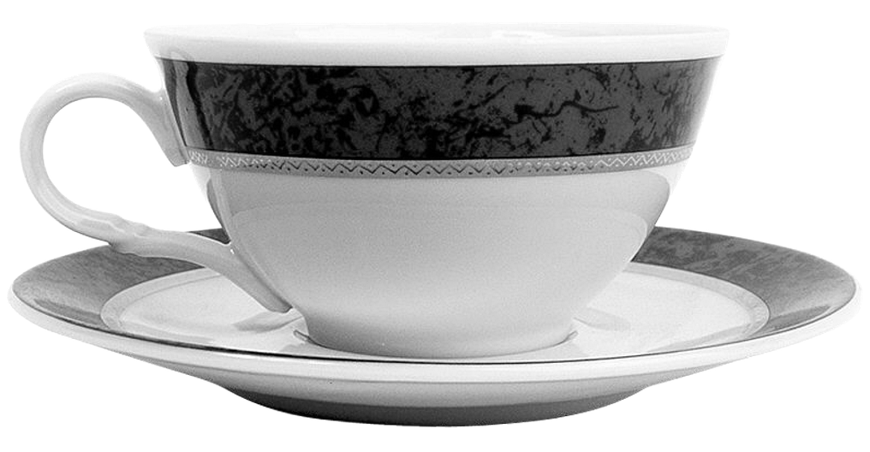
Break
10 min

Slide 26
Let’s share our ideas about the future in small groups and find a common direction
How? Assignment 4
Split up into small groups for 20 minutes.
Write / copy your vision statement in Miro
Discuss: What is common? What is different? From who’s point of view are the visions preferable?
  Remember: Listen. Be kind. Accept different views and respect them.
Choose a vision by voting: each one of you have three votes (red dots).
In Miro, write a concise vision based on the preferred future you’ve chosen. Express the vision like this:
  “In 2050 who/what/where + verb + what”
  (esim. ““In 2050, the carbon footprint of each Finn will be 80% smaller than now”)
After this session we will return to the bigger group.
Notes:
We will split up into small groups for 20 minutes.
Write / copy your vision statement in Miro
Discuss: What is similar? What is different? From who’s point of view are the visions preferable?
Remember: Listen. Be patient. Accept different views and respect them.
Choose a common direction by voting: each of you have three votes (red dots). Try to avoid the kind of compromise that takes into account all the hopes and wishes.
In Miro, write a concise vision based on the preferred future you’ve chosen. Express the vision like this:

Slide 27
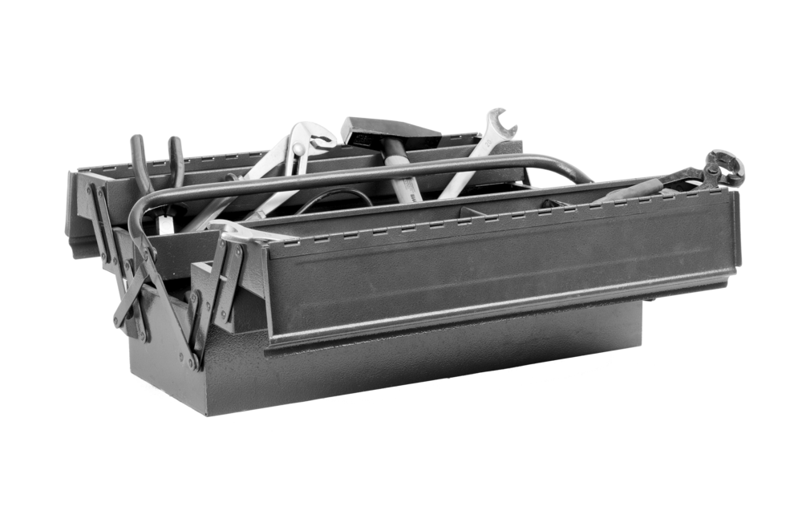
!
1
2
Take action and shape the future.
Why? Because the only way to change the world is to take action.
3
Notes:
In the last part of the workshop we will dive into actions: how can I or my organisation be a change maker?

Slide 28
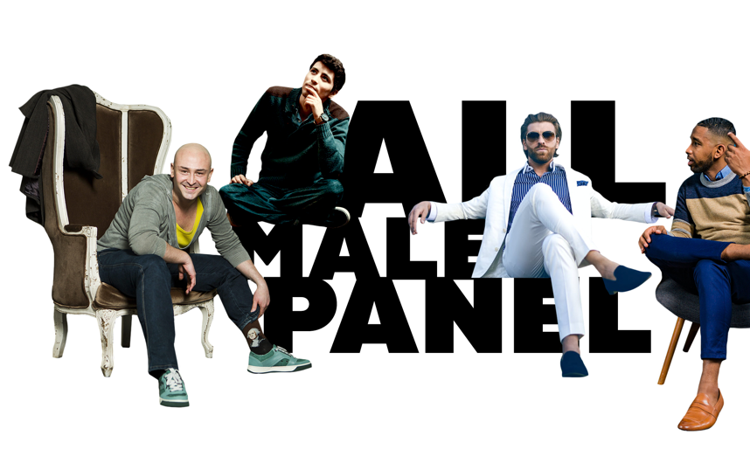

A story of a meme that influenced people’s way of thinking
Researcher Saara Särmä’s David Hasselhoff meme
made “all-male panels” an international viral phenomenon.
Notes:
One meme won’t change the world, but successful work through social media can achieve a lot. Saara Särmä, a researcher in international relations, got tired of seeing all-male panels. She started collecting photos on her Tumblr page of panel discussions with only male participants. She quickly put together a large collection. Eventually, she decided to use humour to gain more visibility for the issue. This led to the “All Male Panel” meme, where the actor David Hasselhoff, a symbol of masculinity, gives the thumbs-up to organisers who have put together an all male panel.
Of course, Särmä wasn’t the first to focus on this issue, but it was only through the meme she created that the issue became a viral phenomenon covered by various international media. The power of the meme lies in using humour to call attention to a serious equality-related issue. A meme has novelty value, simplicity and overlap with many people’s daily experiences. It only takes a moment to understand and share it. It also comes with a fairly simple call to action: an all-male panel is rarely an inevitable option, but rather an easy unconscious choice.

Slide 29
Spheres of transformation
3
Ways of thinking
2
IMPACT SCOPE
Structures
1
Adapted from: Laininen 2018;
O´Brien & Sygna 2013;
Sharma 2007.
Behavior
Notes:
Actions that drive change should be approached from different perspectives. Today, we will focus on three.
Firstly, actions may be related to human behaviour. It can be actions that create new services, technology or innovations that then change people’s behaviour. This can mean for example a shift to a more plant-based diet because there’s more plant-based protein products available. Or related to gender equality, Helsingin Sanomat gender counter that reveals how equally have men and women been interviewed in their stories.
Secondly, action can be related to structural level. Society may guide people’s behaviour and actions through laws and regulations, for example. What is the current tax policy? Does it support the use of fossil fuels or encourage investments in clean energy? Or, is there legislation that requires enterprises to have a certain number of female directors on their boards?
Thirdly, actions that drive change may also be related to paradigms and ways of thinking. The most significant – and also the slowest – change takes place at the level of values, ideals and world views. For example, what is our relationship with nature? Do we see it as having intrinsic value or as a resource for people to use? What kind of action influences people’s paradigms? The all male panel is one example of trying to affect people’s way of thinking.

Slide 30
VISION
Today’s actions shape the future
3
Actions, that influence people’s thinking.
2
Actions that influence structures.
1
Actions, that influence behaviour.

Slide 31
Towards a preferred future
Assignment 5: What actions do we need to make your vision happen?
How?
15 min
Now you’ll be the changemakers
Ideate 3 actions towards your preferred future and document them in Miro
  An action that influence people’s behaviour or practices.
  An action that influence structures (legislation, taxation etc.).
  An action that influence people’s thinking.
Assigment 6: What would the journey towards your chosen vision be like?
How?
10 min
You will spend a moment working in the editorial team of Future News. Create the front page in 2048.
Create a headline that describes the world on the path towards your vision. If you have time, you can add other news as well.

Slide 32


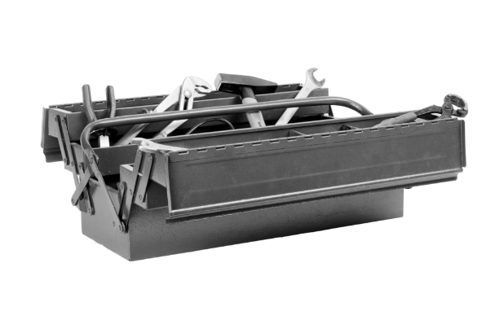
Recap: what did we just do?
1
We challenged assumptions about the future.
2
We imagined preferred futures.
3
We ideated actions to shape the future.
Notes:
A short recap of what we’ve done during this workshop.
First, we challenged assumptions about the future
Then, we imagined preferable futures
Finally, we planned actions that we can take to influence the future
The idea of this process was to link futures thinking into today’s actions

Slide 33
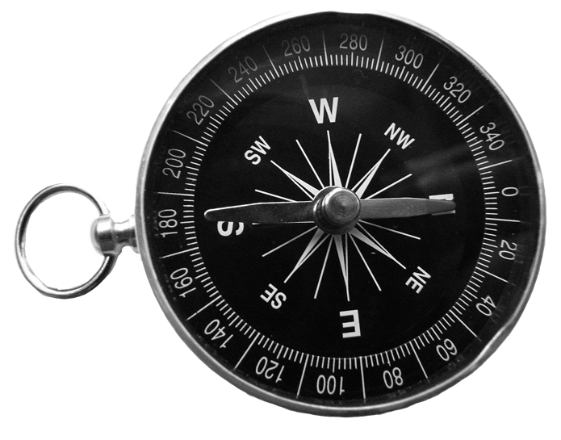
The world is getting better.
I can’t influence things.
I can influence things.
The world is getting worse.
Soveltaen: Fred Polak
Notes:
You can also get an overview of what we have done in this workshop with the help of this matrix.
The way we think about the future and the amount of agency we feel towards it have significant impacts on whether we actually decide to impact the future or not.
This matrix is based on the work of the Dutch sociologist and futurist Fred Polak
Based on people’s different personalities, backgrounds and past experiences, we can roughly place them in the different quadrants of the matrix. Where you would place yourself?
You don’t have to be optimist just for the sake of it. However, right now there are more dystopian images of the future than hopeful or inspiring visions.
You can get motivated to act from the feeling that the world is getting worse, or you can get inspired by the feeling that the world is getting better. Both are ok, but the main questions is, that do you feel you have the agency to change things for the better?

Slide 34
Futures thinking
Shaping the future
Change making
Notes:
Shaping the future consists of futures thinking and change making. We need both.

Slide 35
“Vision without action is daydream, action without vision is nightmare.”
Japanese proverb

Slide 36
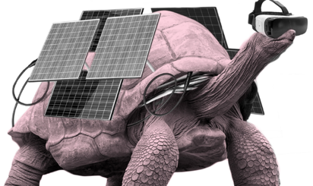
What’s my takeaway?
Notes:
Today you got to work and think together with your group. Hopefully hat gave you new thoughts.
The last question we have for you is what thought or idea will take with you from this workshop. It can be a sentence, something you want to request from yourself or form your colleagues or something else. Take a few minutes to think about it and then write it in the chat.

Slide 37
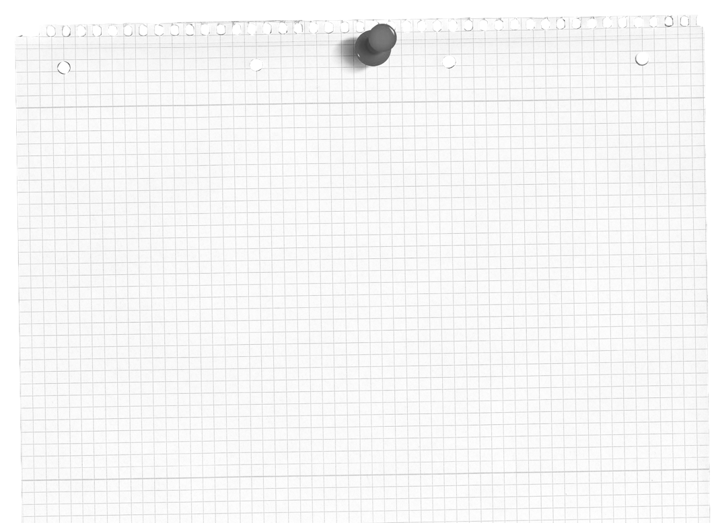
Where can I find more tools to shape the future?
Future Makers Tool Box
https://www.sitra.fi/en/projects/toolbox-for-people-shaping-the-future/

Slide 38
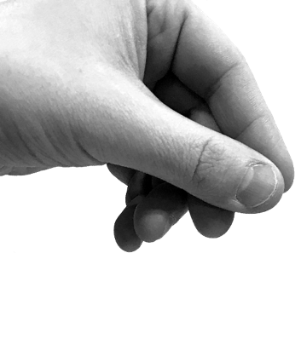
THANK YOU!

